Slide 1
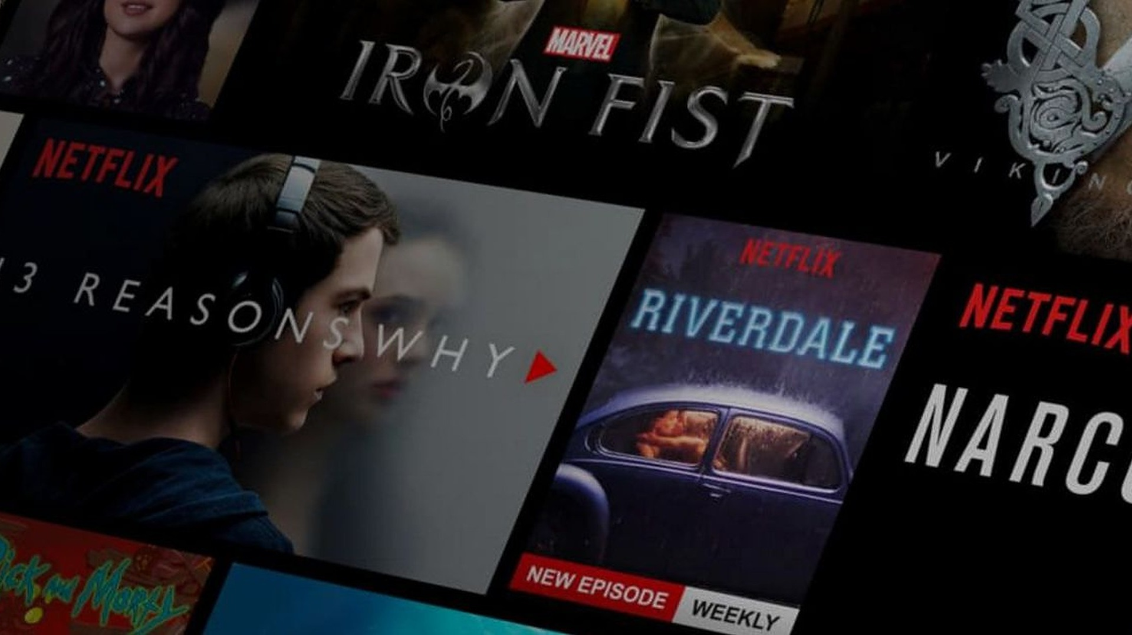
MOVIE RECOMMENDER SYSTEM
M.TEJASRI-1602-20-748-054
M.VAISHNAVI-1602-20-748-056

Slide 2
ABSTRACT :
A movie recommendation system can suggest a set of movies to users based on their interest or the popularity of the movie.
It first captures the watch history and then recommends movie. If the user is a new visitor . System tries to recommend popular movies based on the data set.

Slide 3
Mechanism :
There are three types of filtering
1)Collaborative filtering 2)Content-based filtering 3)Hybrid filtering
In this system, we are going to use content based filtering.
Content-based methods are based on the similarity of movie attributes.
Cosine similarity is a metric used to measure how similar two items are.

Slide 4
Movie Tools :
Movie id
Title
Tags

Slide 5
LIBRARIES :
Pandas: It is used for data manipulation and analysis.
Numpy: Performs variety of mathematical operations on arrays and matrices.
Scikit-learn: Provides framework for content based or user based hybrid model.
Streamlit: It helps to create web app.

Slide 6
DATASET:
We Collected all the required data set from tmdb 5000 movies. In this project we require movie.csv,ratings.csv,users.csv.

Slide 7
Hardware requirements:
• A PC with Windows/Linux OS
• Processor with 1.7-2.4gHz speed
• Minimum of 8gb RAM
• 2gb Graphic card

Slide 8
Software requirements:
• Jupyter
• PyCharm Editor
• Python libraries

Slide 9
CONCLUSION
Recommender systems are a powerful new technology for extracting additional value for a business from its user databases. These systems help users find items they want to buy from a business. Recommender systems benefit users by enabling them to find items they like.

Slide 10
THANK YOU

